Slide 1
Writing Better Requirements
CSE 478 (Fall 2011)

Slide 2
Table of Contents
We can’t write requirements because…
Anatomy of a Good / Bad User Requirement
Standard for Writing a Requirement
Writing Pitfalls to Avoid
A Few Simple Tests…

Slide 3
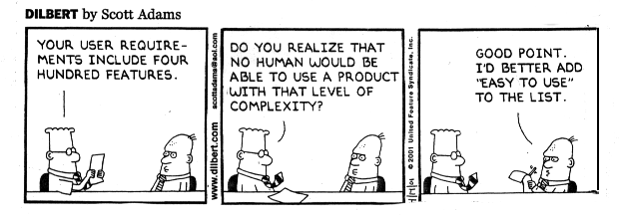

Slide 4

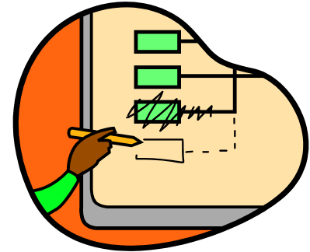
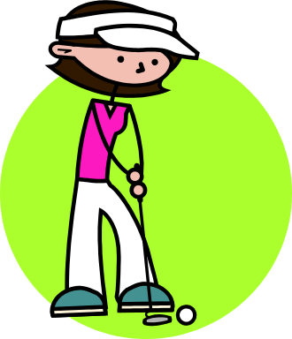
We can’t write requirements because…
We can’t … Good & Bad Standard Pitfalls to Avoid A Few Simple Tests Summary & Tools
don’t know what to do!
  not taught in the course
  don’t know how to write
  don’t understand the process
  don’t have the necessary data
don’t understand why!
  don’t understand the impact / changes
  think this is “just a document”
I’d rather do something else!
  I’d rather design – I see no reward
  don’t have enough time
  I think the review process will catch the errors
Source: Compliance Automation, Inc., 1998

Slide 5
Anatomy of a Good User Requirement
Martha can’t … Good & Bad Standard Pitfalls to Avoid A Few Simple Tests Summary & Tools
Identifies the system under discussion and a desired end result that is wanted within a specified time that is measurable
The challenge is to seek out the system under discussion, end result, and success measure in every requirement
Defines the system under discussion
Verb with correct identifier (shall or may)
The Online Banking System shall allow the Internet user
to access her current account balance in less than 5 seconds.
Defines a positive end result
Quality criteria

Slide 6
Example of a Bad User Requirement
Martha can’t … Good & Bad Standard Pitfalls to Avoid A Few Simple Tests Summary & Tools
Cannot write a requirement on the user
No identifier for the verb
X
The Internet User quickly sees her current
account balance on the laptop screen.
Vague quality criteria
What versus how

Slide 7
Standard for Writing a Requirement
Martha can’t … Good & Bad Standard Pitfalls to Avoid A Few Simple Tests Summary & Tools
Each requirement must first form a complete sentence
  Not a bullet list of buzzwords, list of acronyms, or sound bites on a slide
Each requirement contains a subject and predicate
  Subject: a user type (watch out!) or the system under discussion
  Predicate: a condition, action, or intended result
  Verb in predicate: “shall” / “will” / “must” to show mandatory nature; “may” / “should” to show optionality
The whole requirement provides the specifics of a desired end goal or result
Contains a success criterion or other measurable indication of the quality

Slide 8
Standard for Writing a Requirement
Martha can’t … Good & Bad Standard Pitfalls to Avoid A Few Simple Tests Summary & Tools
Look for the following characteristics in each requirement
  Feasible (not wishful thinking)
  Needed (provides the specifics of a desired end goal or result)
  Testable (contains a success criterion/other measurable indication of quality)
  Clear, unambiguous, precise, one thought
  Prioritized
Note: several characteristics are mandatory (answer a need, verifiable, satisfiable) whereas others improve communication

Slide 9
Writing Pitfalls to Avoid
Martha can’t … Good & Bad Standard Pitfalls to Avoid A Few Simple Tests Summary & Tools
Never describe how the system is going to achieve something (over-specification), always describe what the system is supposed to do
  Refrain from designing the system
    using names of components, materials, software objects, fields & records in the user or system requirements
  Designing the system too early may possibly increase system costs
  Do no mix different kinds of requirements (e.g., requirements for users, system, and how the system should be designed, tested, or installed)
  Do not mix different requirements levels (e.g., the system and subsystems)
    Danger signs: high level requirements mixed in with database design, software terms, or very technical terms

Slide 10
Writing Pitfalls to Avoid
Martha can’t … Good & Bad Standard Pitfalls to Avoid A Few Simple Tests Summary & Tools
“What versus how” test
X
The system shall use Microsoft Outlook to send an
email to the customer with the purchase confirmation.
The system shall inform the customer
that the purchase is confirmed.

Slide 11
Writing Pitfalls to Avoid
Martha can’t … Good & Bad Standard Pitfalls to Avoid A Few Simple Tests Summary & Tools
Never build in let-out or escape clauses
  Requirements with let-outs or escapes are dangerous because of problems that arise in testing
  Danger signs: if, but, when, except, unless, although
    These terms may however be useful when the description of a general case with exceptions is much clearer and complete that an enumeration of specific cases
Avoid ambiguity
  Write as clearly and explicitly as possible
  Ambiguities can be caused by:
    The word or to create a compound requirement
    Poor definition (giving only examples or special cases)
    The words etc, …and so on (imprecise definition)

Slide 12
Writing Pitfalls to Avoid
Martha can’t … Good & Bad Standard Pitfalls to Avoid A Few Simple Tests Summary & Tools
Do not use vague indefinable terms
  Many words used informally to indicate quality are too vague to be verified
  Danger signs: user-friendly, highly versatile, flexible, to the maximum extent, approximately, as much as possible, minimal impact
X
The Easy Entry System shall be easy to use and require
a minimum of training except for the professional mode.

Slide 13
Writing Pitfalls to Avoid
Martha can’t … Good & Bad Standard Pitfalls to Avoid A Few Simple Tests Summary & Tools
Do not make multiple requirements
  Keep each requirement as a single sentence
  Conjunctions (words that join sentences together) are danger signs: and, or, with, also
Do not go for
  Long sentences with arcane (unknowable) language
  References to unreachable documents
X
The Easy Entry Navigator module shall consist of order
entry and communications, order processing, result
processing, and reporting. The Order Entry module shall be
integrated with the Organization Intranet System and
results are stored in the group’s electronic customer record.

Slide 14
Writing Pitfalls to Avoid
Martha can’t … Good & Bad Standard Pitfalls to Avoid A Few Simple Tests Summary & Tools
Do not speculate
  There is no room for “wish lists” – general terms about things that somebody probably wants
  Danger signs: vague subject type and generalization words such as usually, generally, often, normally, typically
Do not express suggestions or possibilities
  Suggestions that are not explicitly stated as requirements are invariably ignored by developers
  Danger signs: may, might, should, ought, could, perhaps, probably
Avoid wishful thinking
  Wishful thinking means asking for the impossible (e.g., 100% reliable, safe, handle all failures, fully upgradeable, run on all platforms)
X
The Easy Entry System may be fully adaptable to all
situations and often require no reconfiguration by the user.

Slide 15
A Few Simple Tests…(1)
Martha can’t … Good & Bad Standard Pitfalls to Avoid A Few Simple Tests Summary & Tools
“What versus how” test discussed earlier
  Example: a requirement may specify an ordinary differential equation that must be solved, but it should not mention that a fourth order Runge-Kutta method should be employed
“What is ruled out” test
  Does the requirement actually make a decision (if no alternatives are ruled out, then no decision has really been made)
  Example: a requirement may be already covered by a more general one
Source: Spencer Smith, McMaster U.

Slide 16
A Few Simple Tests…(2)
Martha can’t … Good & Bad Standard Pitfalls to Avoid A Few Simple Tests Summary & Tools
“Negation” test
  If the negation of a requirement represents a position that someone might argue for, then the original decision is likely to be meaningful
“Find the test” test
  The requirement is problematic if no test can be found or the requirement can be tested with a test that does not make sense
  Test: look, here it is!
X
The software shall be reliable.
X
The car shall have an engine.
Source: Spencer Smith, McMaster U.

Slide 17
Rate these Requirements
Martha can’t … Good & Bad Standard Pitfalls to Avoid A Few Simple Tests Summary & Tools
X
The Order Entry system provides for quick, user-
friendly and efficient entry and processing of all orders.
X
Invoices, acknowledgments, and shipping notices shall
be automatically faxed during the night, so customers
can get them first thing in the morning.
X
Changing report layouts, invoices, labels, and form
letters shall be accomplished.
X
The system shall be upgraded in one whack.
X
The system has a goal that as much of the IS data as
possible be pulled directly from the T&M estimate.

Slide 18
Towards Good Requirements Specifications (1)
Martha can’t … Good & Bad Standard Pitfalls to Avoid A Few Simple Tests Summary & Tools
Valid (or “correct”)
  Expresses actual requirements
Complete
  Specifies all the things the system must do (including contingencies)
  ...and all the things it must not do!
  Conceptual Completeness
  (e.g., responses to all classes of input)
  Structural Completeness
  (e.g., no TBDs!!!)
Consistent
  Doesn’t contradict itself (satisfiable)
  Uses all terms consistently
  Note: inconsistency can be hard to detect, especially in concurrency/timing aspects and condition logic
  Formal modeling can help
Beneficial
  Has benefits that outweigh the costs of development
Source: Adapted from Blum 1992, pp164-5 and the IEEE-STD-830-1993

Slide 19
Towards Good Requirements Specifications (2)
Martha can’t … Good & Bad Standard Pitfalls to Avoid A Few Simple Tests Summary & Tools
Necessary
  Doesn’t contain anything that isn’t “required”
Unambiguous
  Every statement can be read in exactly one way
  Clearly defines confusing terms
  (e.g., in a glossary)
Uniquely identifiable
  For traceability and version control
Verifiable
  A process exists to test satisfaction of each requirement
  “every requirement is specified behaviorally”
Understandable (clear)
  E.g., by non-computer specialists
Modifiable
  Must be kept up to date!
Source: Adapted from Blum 1992, pp164-5 and the IEEE-STD-830-1993

Slide 20
Typical Mistakes
Martha can’t … Good & Bad Standard Pitfalls to Avoid A Few Simple Tests Summary & Tools
Noise = the presence of text that carries no relevant information to any feature of the problem
Silence = a feature that is not covered by any text
Over-specification = text that describes a feature of the solution, rather than the problem
Contradiction = text that defines a single feature in a number of incompatible ways
Ambiguity = text that can be interpreted in >=2 different ways
Forward reference = text that refers to a feature yet to be defined
Wishful thinking = text that defines a feature that cannot possibly be validated
Jigsaw puzzles = e.g., distributing requirements across a document and then cross-referencing
Inconsistent terminology = inventing and then changing terminology
Putting the burden on the development staff = i.e. making the reader work hard to decode the intent
Writing for the hostile reader (fewer of these exist than friendly ones)
Source: Steve Easterbrook, U. of Toronto

Slide 21
Key Questions and Characteristics
Martha can’t … Good & Bad Standard Pitfalls to Avoid A Few Simple Tests Summary & Tools
Remember the key questions “Why?” or “What is the purpose of this?”
Feasible
Needed
Testable

